Slide 1
ScanFi – The WiFi Locator
.

Slide 2

The present localisation systems (GPS) do not work precisely for indoor conditions. We aim at making a prototype robot which can localise a black box emitting distress Wi-Fi signals in indoor conditions.

Slide 3
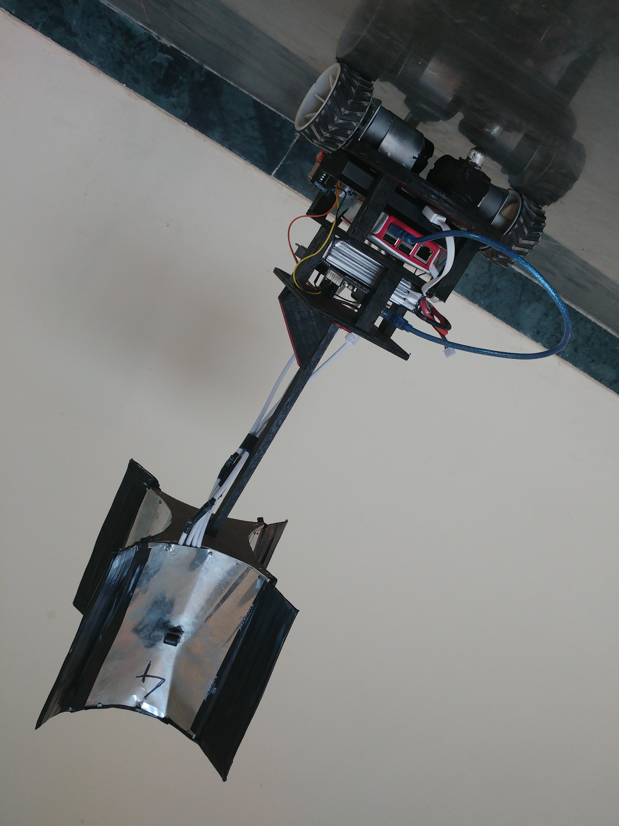
The solution
Fast and Reliable

Slide 4
How we approach
Step 1
Step 2
Step 3
Mathematical Model
Problem Statement was simulated on MATLAB for modelling of RSSI and various path planning algorithms were developed.
Hardware Design
Fabricated various Rx designs corresponding to the different path planning algorithms including single reciever & multiple reciever models.
Embedded System Design
Examined all required functionality for the robot and adopted best possible electronics available in the market.

Slide 5

Mechanical Design
Chassis + Antenna Module

Slide 6
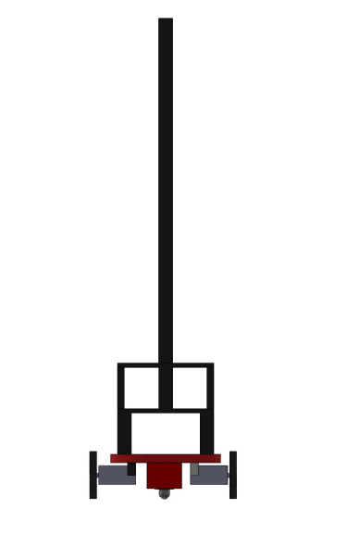
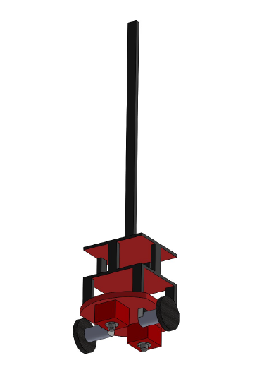
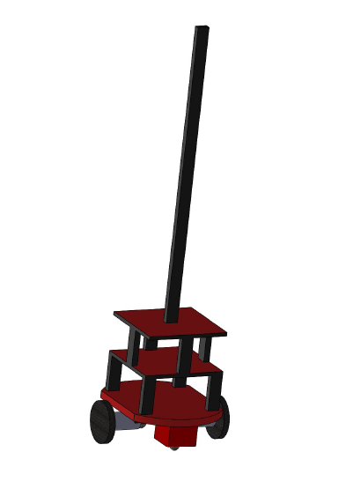
Chassis Design

Slide 7
Mechanical Design
The size of the robot was kept small keeping in mind target accuracy of 50 cm.
Base of the bot is circular to provide symmetry.
It is a differential drive robot with two DC encoder motors and two castor wheels.
Receiver Module Designs:
The single antenna system
The multiple antenna system

Slide 8
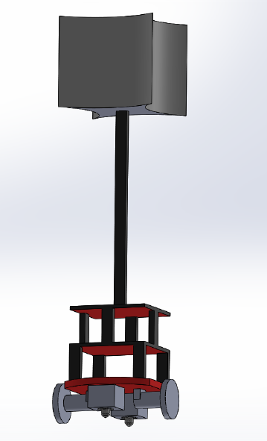
Mechanical Design
Multiple Receiver Module
Single Receiver Module

Slide 9
Mathematical Modelling And Path Planning
Developed and simulated a suitable path loss model (on MATLAB) to calculate the Received Signal Strength Index (RSSI), keeping in mind the indoor environments.
Simulations were done to generate near – real life conditions, keeping in mind the constraints such as quantized values of RSSI and additive noise.
Path-Planning was done by implementing stochastic gradient descent adaptive filter or the Least Mean Squared algorithm to minimise the least mean square of the error signal.

Slide 10
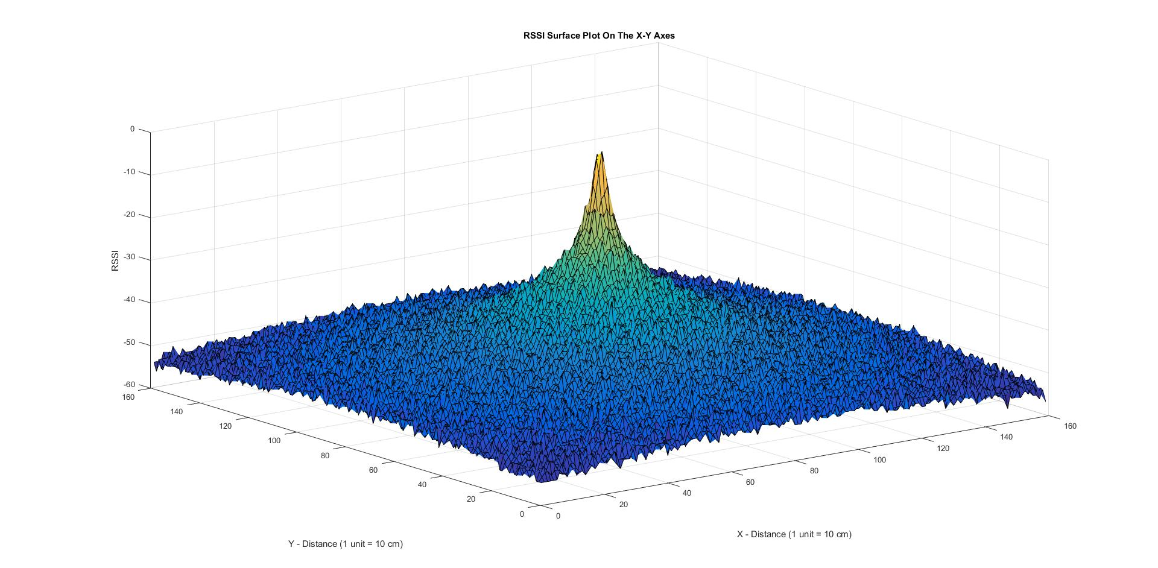

Slide 11
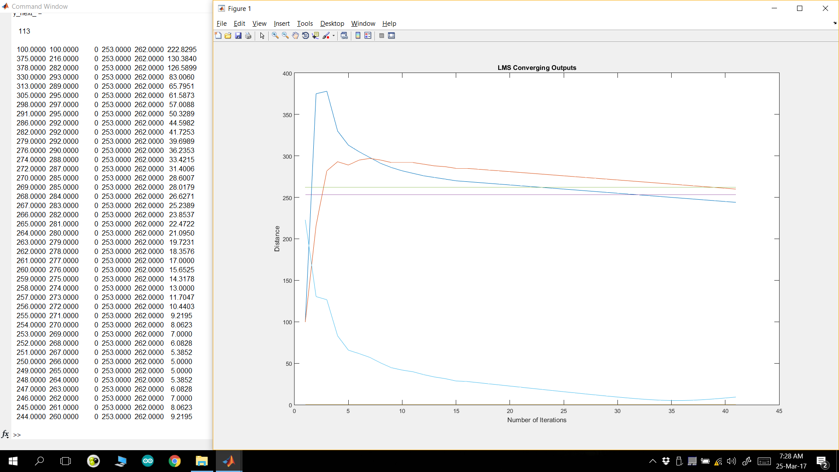

Slide 12
Embedded System
Components & Design

Slide 13
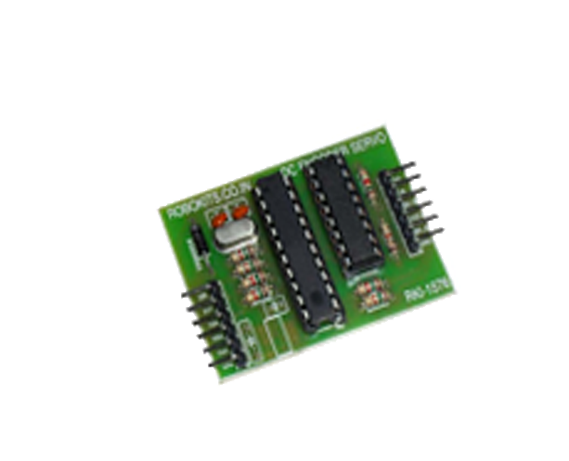
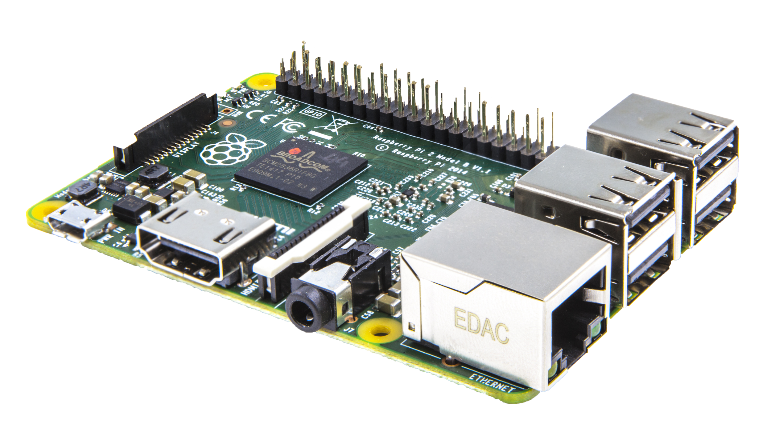
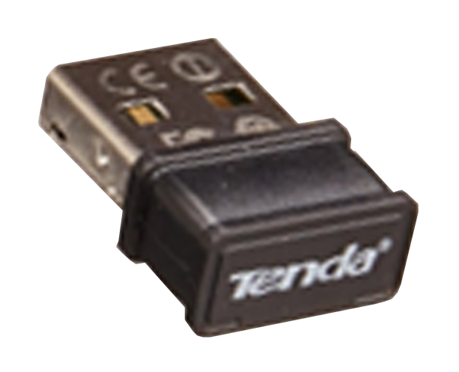
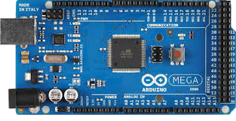
Why these?
Raspberry Pi 3 – High Level Controller
Arduino Mega – Low Level Controller
Wifi Adapters Tenda
Serial DC encoder Driver
1 GB RAM
4 USB ports with 40 GPIO pins
Ethernet Connectivity
Powerful on-board computer
8 KB SRAM
15 PWM pins
Small and Cheap
Easy USB connectivity
Easy connectivity
Signal coverage upto 9 metres
Cheap and easily availabe
Wide driver supply range (7V to 12V)
Serial converter to Arduino
PID on Position Control

Slide 14
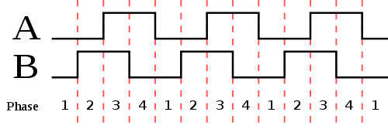
Robot control design:
Robot control is coded on Arduino Mega which receives commands over serial communication from Raspberry Pi.
The PID controller has been employed on position control of the motors to navigate the robot precisely.
The controller receives commands from Arduino through UART communication.

Slide 15
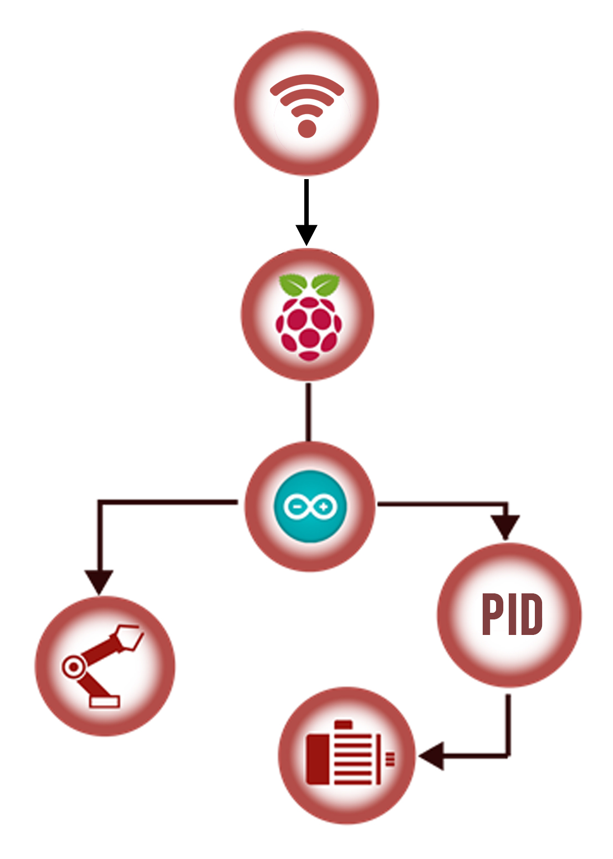
System Architecture

Slide 16
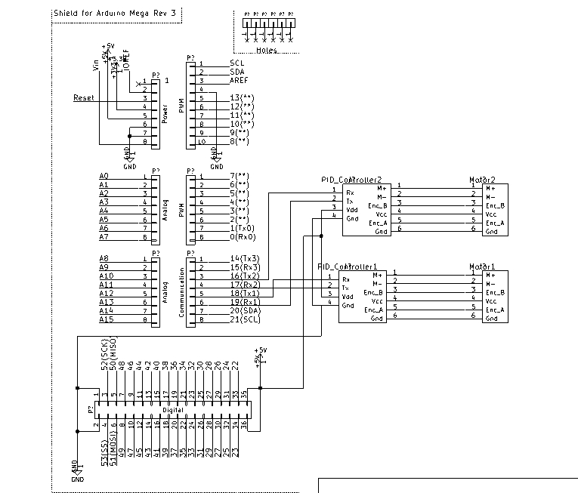
Circuit Schematic

Slide 17
Cost Analysis
COMPONENT | QUANTITY | COST
Raspberry Pi 2 | 1 | Rs 2500
Arduino Mega | 1 | Rs 750
DC encoder Motors | 2 | Rs 3500
Wifi Adapters | 4 | Rs 1400
Power Bank | 1 | Rs 600
Battery | 1 | Rs 1400
Chassis | - | Rs 500
Total |  | Rs 10650

Slide 18
Thank You

